Slide 1

Clients’ churn prediction
Valentyn Burenkov

Slide 2

Aim of the model
Business goal
To retain clients before 2 month of their actual churn (no incoming events, no outgoing events, no paid events)
Task
To detect clients that will churn in 2 month
Task type
Binary classification

Slide 3
Business understanding
1) Enhanced understanding of the of the client’s future behavior
2) Marketing companies, intended to retain the client
3) Income prediction

Slide 4
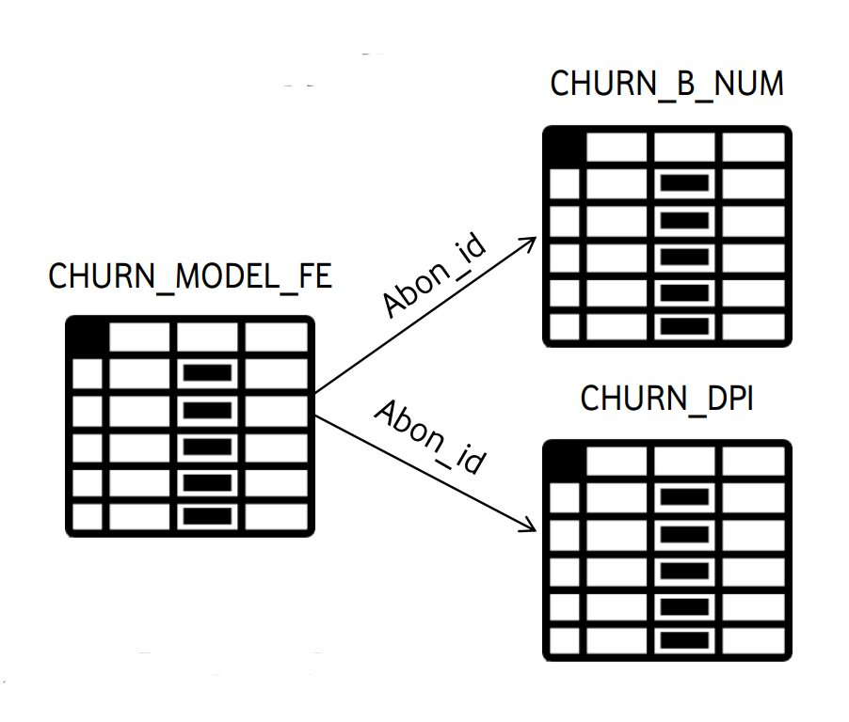
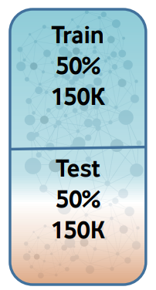
Input data understanding
Input data description
1) General information about clients (300_000 rows, ~800 characteristics)
2) Information about clients calls
3) Information about clients application usage

Slide 5
Algorithm selection
LightGBM
Faster training speed and higher efficiency.
Lower memory usage.
Better accuracy.
Support of parallel, distributed, and GPU learning.
Capable of handling large-scale data.

Slide 6
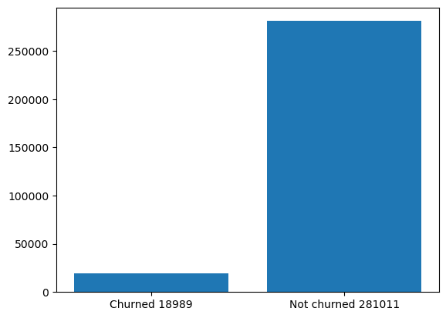
Dataset balance
6%
94%

Slide 7
Iterative feature selection flow chart

Slide 8
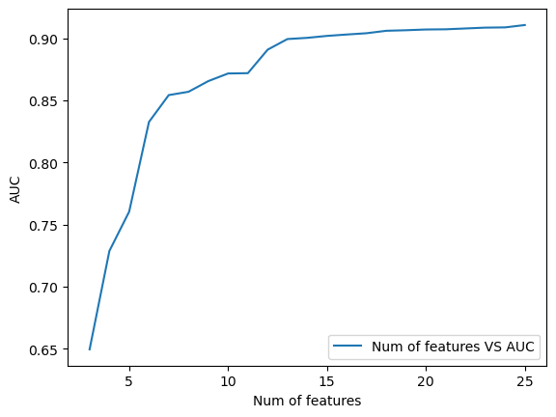
Number of features vs AUC

Slide 9
Telephone feature engineering
Check inbound calls from non-vodafone number in minutes
Check outbound calls to non-vodafone number in minutes
SMS from non-vodafone number count
SMS to non-vodafone number count
SMS to pawnshops, micro credit organizations
SMS from pawnshops, micro credit organizations
Total features taken to final mode: 0

Slide 10
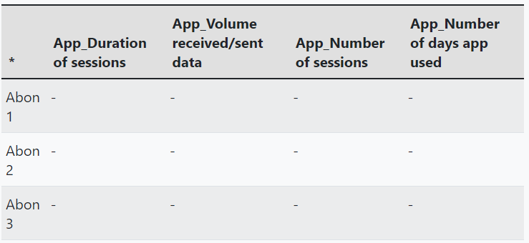
Application feature engineering
Add the following information for every user for every application
Total applications: 776
Total features taken to final mode: 9

Slide 11
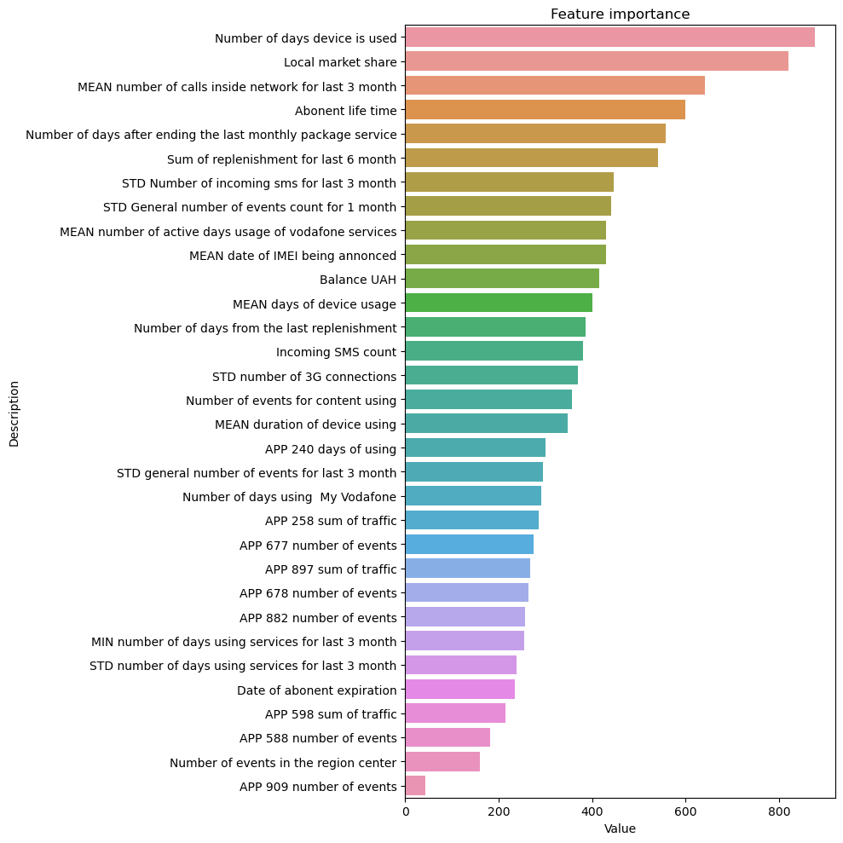
Final feature set has 32 features

Slide 12
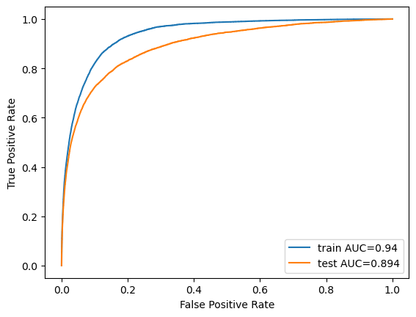
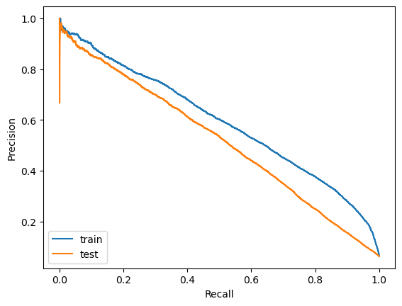
Metrics Train AUC = 0.94 Test AUC = 0.894
ROC curve answers the question of how well the model performs with no knowledge of the class imbalance, whilst the PR curve uses our estimated class imbalance baseline to inform us of how well our model performs, given the specific imbalance we provided it.
Precision-Recall (PR) curve is specifically tailored for the detection of rare events and is the metric that should be used when the positive class is of more interest than the negative one

Slide 13
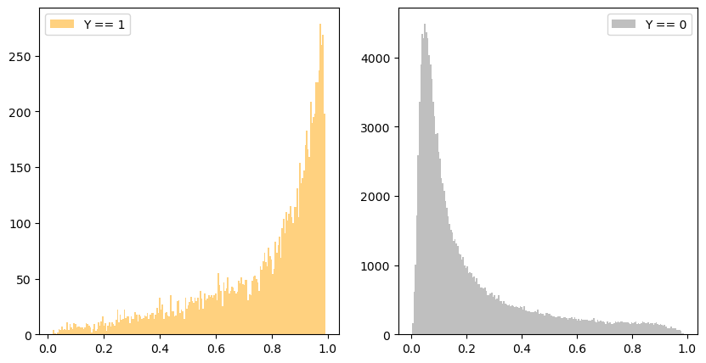
Probability distribution
Y==1 mean churned clients
Y==0 mean non-churned clients

Slide 14
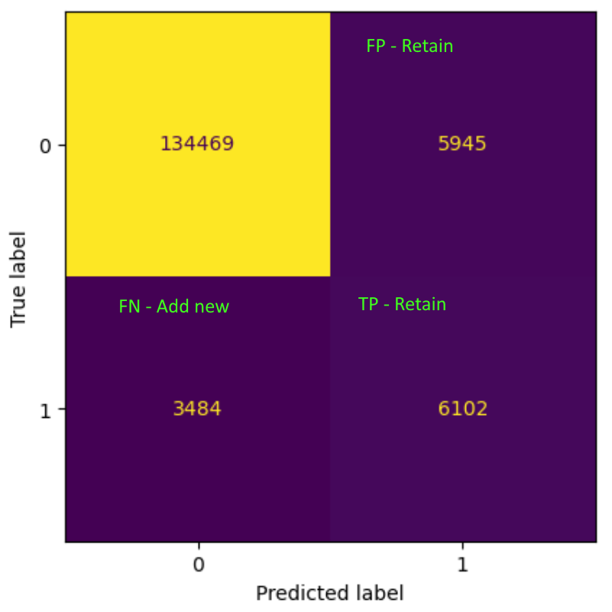
F1 based threshold selection 0.23

Slide 15
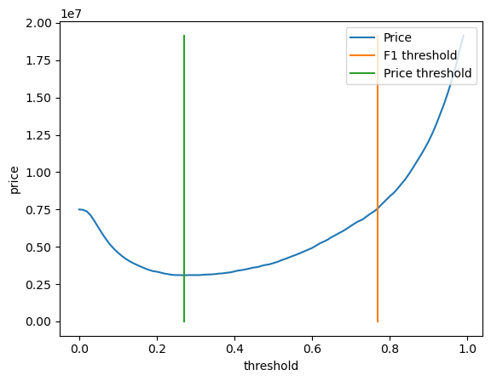
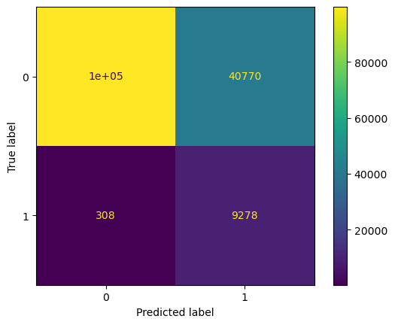
Expenses based threshold 0.78
Expenses = TP* RETAIN + FP*RETAIN + FN*ADD_NEW
Let’s assume that retain price is 50 UAH, add new client price (including missed income) is 4000 UAH.
F1 price: 14_573_400 UAH
Price based: 3_734_400 UAH
Do nothing: 38_344_000 UAH

Slide 16
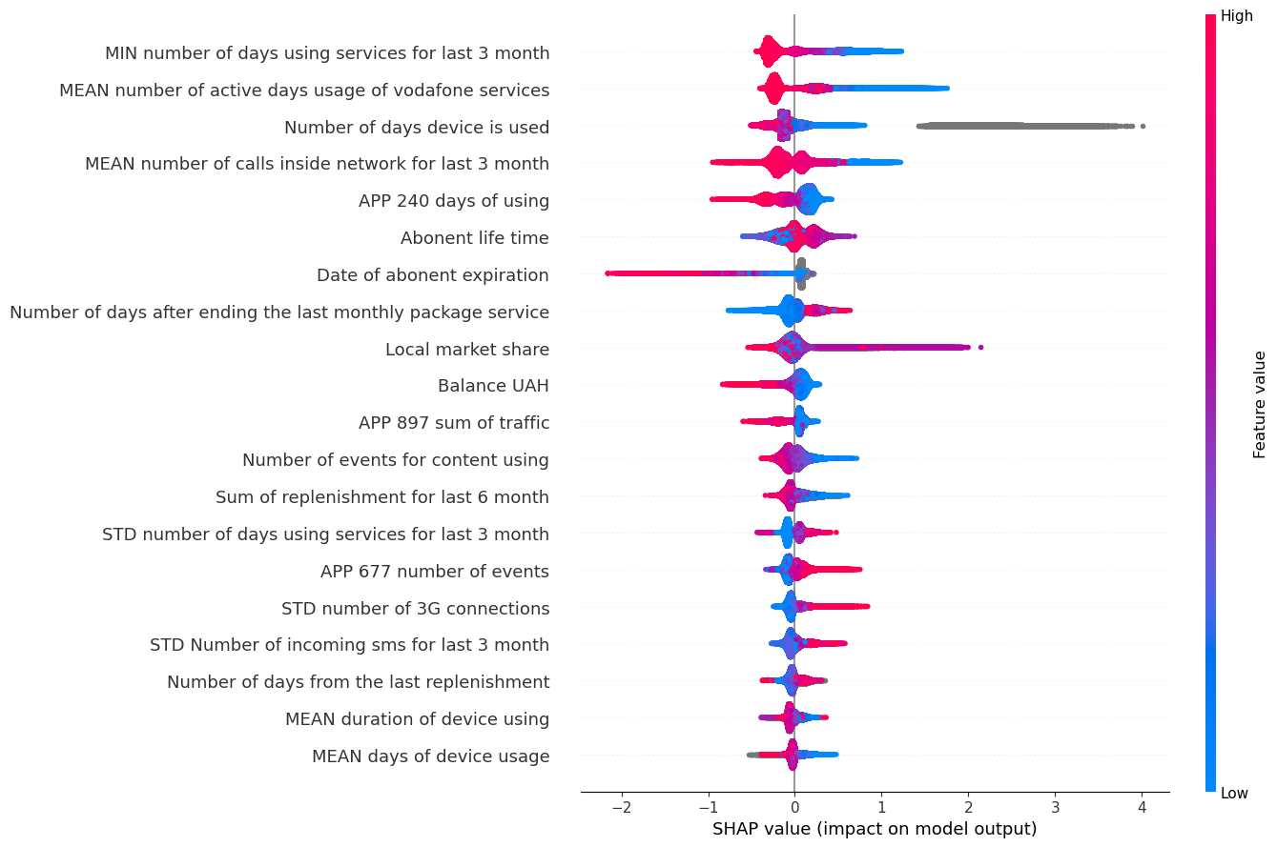
SHAP 1) App 240 less using – chorn 2) App 897 less traffic – chorn 3) App 677 more events – chorn 4) More 3G – chorn 5) Number of incoming sms increase - churn

Slide 17
Future enhancements
Use model ensembles
Use models of different types

